Slide 1
过滤器和监听器
崔剑

Slide 2
主要内容
掌握过滤器的使用
掌握监听器的使用

Slide 3
日常生活中的过滤场景
超市
书店
广场

Slide 4
过滤器
浏览器
Browser
请求过滤
JSP
Servlet
Web应用程序

Slide 5
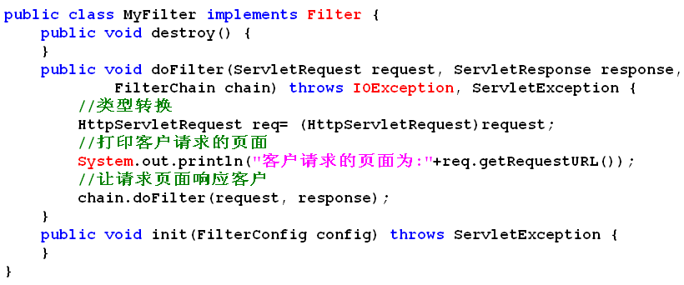
一个简单的例子
获取客户请求

Slide 6
配置过滤器
<filter>
<filter-name>myfilter</filter-name>
<filter-class>com.web.MyFilter</filter-class>
</filter>
<filter-mapping>
<filter-name>myfilter</filter-name>
<url-pattern>/index.jsp</url-pattern>
</filter-mapping>

Slide 7
使用过滤器解决中文乱码
request.setCharacterEncoding("utf-8");
//类型转换
HttpServletRequest req= (HttpServletRequest)request;
//统一设置请求参数的编码
req.setCharacterEncoding("utf-8");
//让请求页面响应客户
chain.doFilter(request, response);
演示FilterConfig类的作用
演示过滤器链

Slide 8
监听器
回顾Swing中的Listener
监听的对象是什么?

Slide 9
JavaWeb中的监听器
监听的对象是什么?
(ServletContext)Application
(HttpSession)Session
(ServletRequest)Request

Slide 10
监听事件
Listener接口 | Event类
ServletContextListener | ServletContextEvent
ServletContextAttributeListener | ServletContextAttributeEvent
HttpSessionListener | HttpSessionEvent
HttpSessionAttributeListener | HttpSessionBindingEvent
HttpSessionActivationListener | HttpSessionEvent
HttpSessionBindingListener | HttpSessionBindingEvent
ServletRequestListener | ServletRequestEvent
ServletRequestAttributeListener | ServletRequesAttributetEvent

Slide 11
ServletContextListener
监听ServletContext(Application)的创建与销毁
public class ServletContextListenerDemo implements ServletContextListener {
public void contextDestroyed(ServletContextEvent event) {
System.out.println("Application销毁");
}
public void contextInitialized(ServletContextEvent event) {
System.out.println("Application创建");
}
}
配置web.xml
<listener>
<listener-class>com.web.ServletContextListenerDemo</listener-class>
</listener>

Slide 12
ServletContextAttributeListener
监听ServletContext(Application)的属性的增加/删除/修改
public void attributeAdded(ServletContextAttributeEvent event) {
System.out.println("增加属性:"+event.getName());
}
public void attributeRemoved(ServletContextAttributeEvent event) {
System.out.println("删除属性:"+event.getName());
}
public void attributeReplaced(ServletContextAttributeEvent event) {
System.out.println("修改属性:"+event.getName());
}
测试:
<%
application.setAttribute("counter","1");
application.setAttribute("counter","2");
application.removeAttribute("counter");
%>

Slide 13
HttpSessionListener
监听HttpSession(session)的创建与销毁
public void sessionCreated(HttpSessionEvent event) {
System.out.println("sessionCreated新的会话产生");
}
public void sessionDestroyed(HttpSessionEvent event) {
System.out.println("sessionDestroyed会话销毁");
}

Slide 14
统计在线人数
public class ListenerDemo implements HttpSessionListener
{
private static int counter;
public void sessionCreated(HttpSessionEvent event) {
System.out.println("在线人数增加");
counter++;
}
public void sessionDestroyed(HttpSessionEvent event) {
System.out.println("在线人数减少");
counter--;
}
public static int getCounter() {
return counter;
}
}

Slide 15
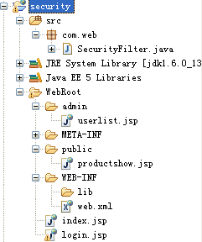
这个文件夹中的页面需登录才可以访问
未登录转向的页面
登录页面

Slide 16
SecurityFilter.java
public class SecurityFilter implements Filter {
private String loginfile;
public void destroy() {
}
public void doFilter(ServletRequest request, ServletResponse response,
FilterChain filterChain) throws IOException, ServletException {
HttpServletRequest req= (HttpServletRequest)request;
HttpServletResponse res= (HttpServletResponse)response;
HttpSession session =req.getSession();
System.out.println(session.getAttribute("login"));
//如果没有登录,转到登录页面
if (session.getAttribute("login")!=null){
filterChain.doFilter(req, res);
}else{
req.getRequestDispatcher(“login.jsp”).forward(request, response);
}
}
public void init(FilterConfig config) throws ServletException {
loginfile = config.getInitParameter("loginfile");
}
}

Slide 17
配置
<filter>
<filter-name>security</filter-name>
<filter-class>com.web.SecurityFilter</filter-class>
<init-param>
<param-name>loginfile</param-name>
<param-value>/index.jsp</param-value>
</init-param>
</filter>
<filter-mapping>
<filter-name>security</filter-name>
<url-pattern>/admin/*</url-pattern>
</filter-mapping>

